Slide 1
Introduction to Information Security

Slide 2
Software Security
Prevents the following:
  Leaks of confidential data.
  Alternation of data without the knowledge of system.
  Unauthorized access to system
  Any expected system operations caused by a malicious user.
  Users or agents should perform only actions that are allowed.

Slide 3
Software Security
No system is absolutely 100% secure.
Software engineers should build systems which should resist against security attacks.
Software piracy and system protection are two primary security problems in field of software engineering.

Slide 4
Software Piracy
Illegal copying and/or distribution of copyrighted software without the permission of the copyright holder.
Piracy is an activity which is easy to perform.
No option of technical support and updates but usage of software.

Slide 5
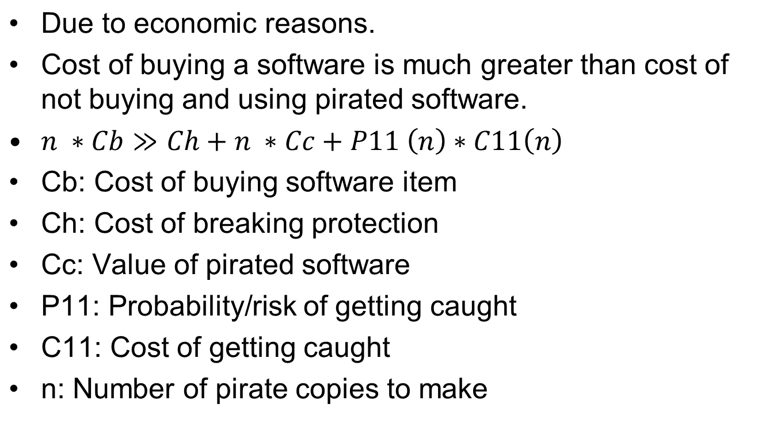
Why do software piracy exists?

Slide 6
Why do software piracy exists?
P11(n): Probability of getting caught is too small todays.
Cc: cost of pirated software is much lower due to CD/DVD writers reducing cost.
How to discourage piracy?
  Reduce Cb: use of open source software
  Increase the Ch: improve the copy protection in software

Slide 7
Software Piracy Protection
Licensing and code protection
Licensing means a software will run only with a matching external information called license.
Code protection means making changes to software program that prevent malicious users from accessing the internal state of the software.

Slide 8
Licensing
License is shipped with software product
Product checks for license information whenever it starts.
Common information in license:
  Expiration date
  Product version
  Maximum number of users
  Deployment environment unique data (DEUD)
    CPU serial no + MAC address + Main HD serial no + vendor generated magic string
    MD5 hash of this value

Slide 9
Introduction to Information Security

Slide 10
Code Protection
A code which is hidden before execution of software and an independent key is retrieved which is used to encrypt/decrypt the software.
The key may be in
  Software form
  Hardware form – it means software can run only on a specific machine

Slide 11
Security challenges in software engineering
Security does not equate to revenue
  Goal of software engineering: minimum effort and resources and maximum results.
  Software architects should be trained to view security as vehicle to prevent revenue from being destroyed.
No software system is perfectly secure
  Building 100% secure system is either too expensive or impossible.

Slide 12
Security challenges in software engineering
Malicious software continuously developed to cause destruction to software.
Security depends on more than technologies.
  Policies are as important as technology
No universal tools to build security models and measure success of security
  Security is an after thought activity in software development
  No tools for measuring software security

Slide 13
Security challenges in software engineering
Security infrastructure mismatches
  Each platform has its own implementations of security issues.
  No standard single approach for such issues available
How to ensure security with COTS Components.
  COTS components are secure when integrated with software to be developed.

Slide 14
Introduction to Information Security

Slide 15
The Systems Development Life Cycle
Systems development life cycle (SDLC) is methodology and design for implementation of information security within an organization
Methodology is formal approach to problem-solving based on structured sequence of procedures
Using a methodology
  ensures a process to be strictly followed.
  avoids missing steps.
Goal is creating a comprehensive security posture/program.
Traditional SDLC consists of six general phases
Notes:
The Systems Development Life Cycle
Information security must be managed in a manner similar to any other major system implemented in the organization.
The best approach for implementing an information security system in an organization with little or no formal security in place, is to use a variation of the Systems Development Life Cycle (SDLC): the Security Systems Development Life Cycle (SecSDLC).
Methodology
The SDLC is a methodology for the design and implementation of an information system in an organization.
A methodology is a formal approach to solving a problem based on a structured sequence of procedures.
Using a methodology ensures a rigorous process, and avoids missing those steps that can lead to compromising the end goal.
The goal is creating a comprehensive security posture.

Slide 16
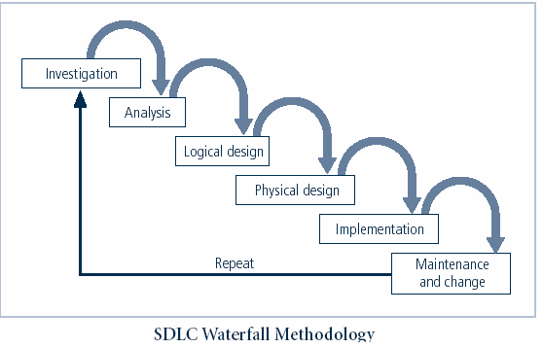
Notes:
Very much a traditional SDLC diagram.

Slide 17
The Security Systems Development Life Cycle
The same phases used in traditional SDLC may be adapted to support specialized implementation of an IS project
Identification of specific threats and creating controls to counter them
SecSDLC is a coherent program rather than a series of random, seemingly unconnected actions
Notes:
The Security Systems Development Life Cycle
The same phases used in the traditional SDLC can be adapted to support the specialized implementation of a security project.
The fundamental process is the identification of specific threats and the creation of specific controls to counter those threats.
The SecSDLC unifies the process and makes it a coherent program rather than a series of random, seemingly unconnected actions.

Slide 18
Investigation
Identifies process, outcomes, goals, and constraints of the project
Begins with enterprise information security policy
Organizational feasibility analysis is performed
Notes:
Investigation
The investigation of the SecSDLC begins with a directive from upper management, dictating the process, outcomes and goals of the project, as well as the constraints placed on the activity.
Frequently, this phase begins with a statement of program security policy that outlines the implementation of security.
Teams of responsible managers, employees and contractors are organized, problems analyzed, and scope defined, including goals objectives, and constraints not covered in the program policy.
Finally, an organizational feasibility analysis is performed to determine whether the organization has the resources and commitment necessary to conduct a successful security analysis and design.

Slide 19
Analysis
Documents from investigation phase are studied
Analyzes existing security policies or programs, along with documented current threats and associated controls
Positive and Negative Use Cases
  Denial of Service attack scenario
  Buffer overflow scenario
Notes:
Analysis
In the analysis phase, the documents from the investigation phase are studied.
The development team conducts a preliminary analysis of existing security policies or programs, along with documented current threats and associated controls.
This phase also includes an analysis of relevant legal issues that could impact the design of the security solution.
The risk management task - identifying, assessing and evaluating the levels of risk facing the organization, also begins in this stage.

Slide 20
Logical Design
Creates and develops blueprints for information security
Rule Based Authentication
Role Based Authorization
Notes:
Logical Design
The logical design phase creates and develops the blueprints for security, and examines and implements key policies that influence later decisions.
Also at this stage, critical planning is developed for incident response actions to be taken in the event of partial or catastrophic loss.
Next, a feasibility analysis determines whether or not the project should continue or should be outsourced.
Physical Design
In the physical design phase, the security technology needed to support the blueprint outlined in the logical design is evaluated, alternative solutions generated, and a final design agreed upon.
The security blueprint may be revisited to keep it synchronized with the changes needed when the physical design is completed.
Criteria needed to determine the definition of successful solutions is also prepared during this phase.
Included at this time are the designs for physical security measures to support the proposed technological solutions.
At the end of this phase, a feasibility study should determine the readiness of the organization for the proposed project, and then the champion and users are presented with the design.
At this time, all parties involved have a chance to approve the project before implementation begins.

Slide 21
Physical Design
Needed security technology is evaluated, alternatives generated, and final design selected
  Which programming language to be used.
  Which data structures are suitable.
  Risk analysis.

Slide 22
Implementation
Security solutions are acquired, tested, implemented, and tested again
Personnel issues evaluated; specific training and education programs conducted
Detailed code review
Verification with code analysis tools
Notes:
Implementation
The implementation phase is similar to the traditional SDLC.
The security solutions are acquired (made or bought), tested, and implemented, and tested again.
Personnel issues are evaluated and specific training and education programs conducted.
Finally, the entire tested package is presented to upper management for final approval.

Slide 23
Testing and Maintenance
Perhaps the most important phase, given the ever-changing threat environment
Testing of software for positive and negative use cases.
Penetration testing to check weaknesses in software.
Notes:
Maintenance and Change
The maintenance and change phase, though last, is perhaps most important, given the high level of ingenuity in today’s threats.
The reparation and restoration of information is a constant duel with an often-unseen adversary.
As new threats emerge and old threats evolve, the information security profile of an organization requires constant adaptation to prevent threats from successfully penetrating sensitive data

Slide 24
Case Study
Student Information System of a university.
Modules of system:
  Student registration for semester.
  Attendance module
  Examination results module
  Reporting module
    Award lists
    Attendance lists

